Slide 1

Sampled MuZero
Learning and Planning in Complex Action Spaces
Thomas Hubert, Julian Schrittwieser, David Silver et al.
Presented By: Manor Zvi
048720 – Robot Learning

Slide 2

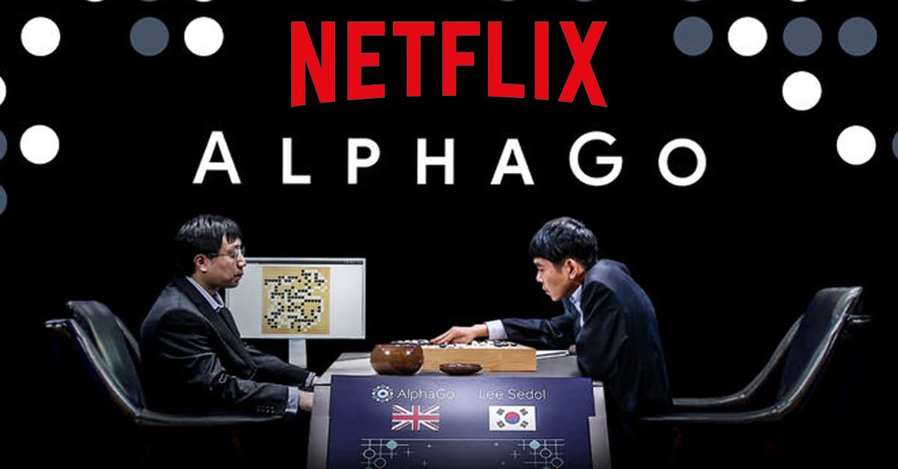
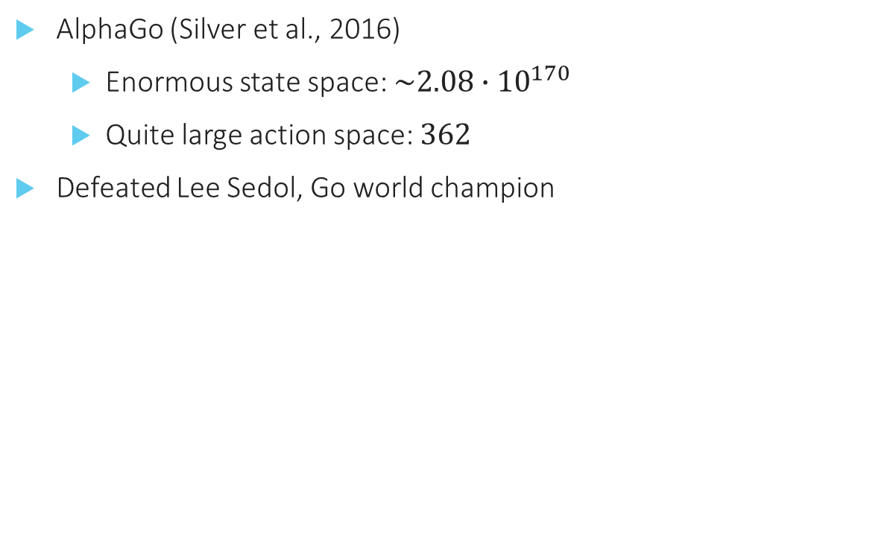
The story begins
AlphaGo (Silver et al., 2016)
Enormous state space: $\sim 2.08∙10^{170}$
Quite large action space: $362$
Defeated Lee Sedol, Go world champion
Notes:
State space size: 19x19 board, each cell can be empty, black or white. Hence $3^{{19}^{2}}$, but only $\sim 1.2\%$ are legal.
Action space size: ${19}^{2}$ to place a key + 1 to skip the turn

Slide 3
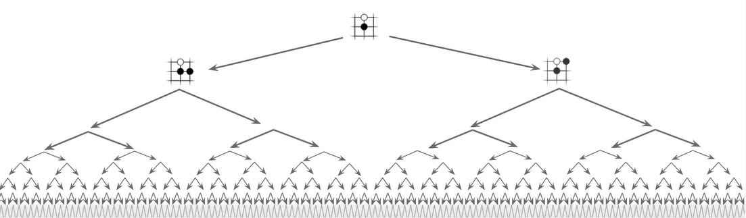
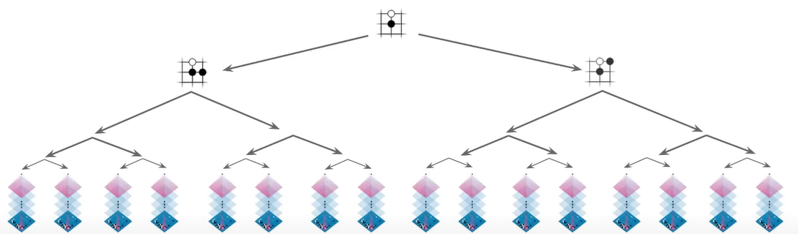
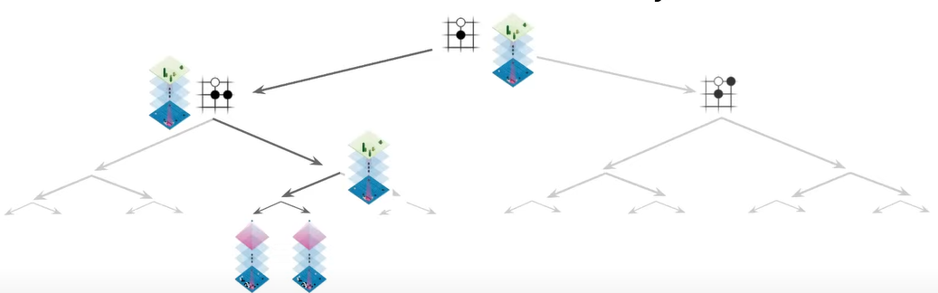
AlphaGo (2016)
Action space and game horizon are too big for ‘vanilla’ heuristic tree search
Uses Value network to reduce the depth – only look ahead a few steps
Uses Policy network to reduce the width of the tree – only look at the most promising actions
They call it ‘a prior network’
Notes:
Each one of them is quite powerful:
One could use the policy alone; play the action it predicts as most likely and get quite descent results
Similarly, one could use the value network alone, play at each state the action with the highest value, and also have success
However, combining both estimates leads to even better results.

Slide 4
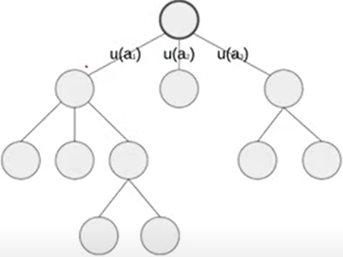
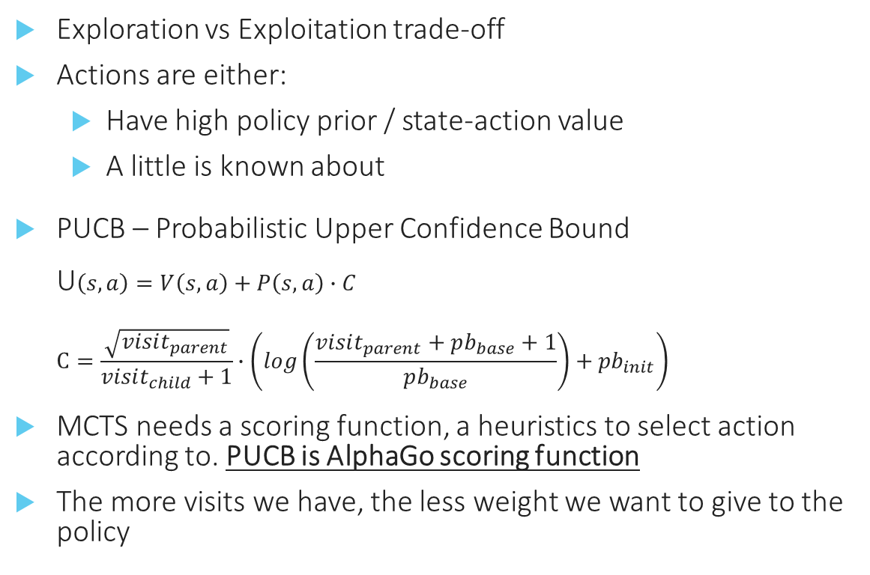
MCTS – Monte Carlo Tree Search
Exploration vs Exploitation trade-off
Actions are either:
Have high policy prior / state-action value
A little is known about
PUCB – Probabilistic Upper Confidence Bound U$\left(s,a\right)=V\left(s,a\right)+P\left(s,a\right)∙C$ $C=\frac{\sqrt{visit_{parent}}}{visit_{child}+1}∙\left(log\left(\frac{visit_{parent}+pb_{base}+1}{pb_{base}}\right)+{pb}_{init}\right)$
MCTS needs a scoring function, a heuristics to select action according to. PUCB is AlphaGo scoring function
The more visits we have, the less weight we want to give to the policy
Apply PUCB from the root until we get a leaf node
Notes:
C is a scaling factor that ensures that the influence of the prior diminishes as our value estimate becomes more accurate.

Slide 5
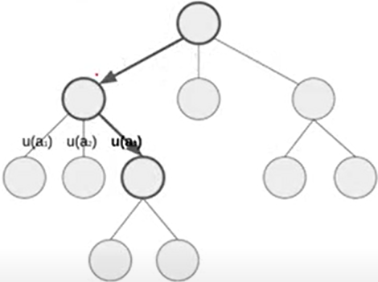
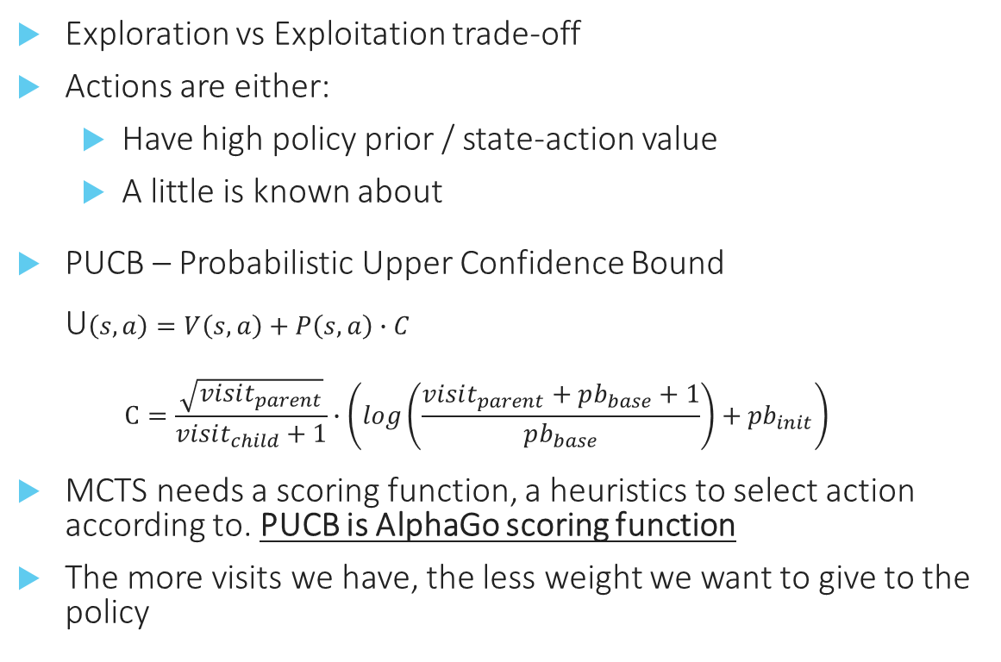
MCTS – Monte Carlo Tree Search
Exploration vs Exploitation trade-off
Actions are either:
Have high policy prior / state-action value
A little is known about
PUCB – Probabilistic Upper Confidence Bound U$\left(s,a\right)=V\left(s,a\right)+P\left(s,a\right)∙C$ $C=\frac{\sqrt{visit_{parent}}}{visit_{child}+1}∙\left(log\left(\frac{visit_{parent}+pb_{base}+1}{pb_{base}}\right)+{pb}_{init}\right)$
MCTS needs a scoring function, a heuristics to select action according to. PUCB is AlphaGo scoring function
The more visits we have, the less weight we want to give to the policy
Apply PUCB from the root until we get a leaf node

Slide 6
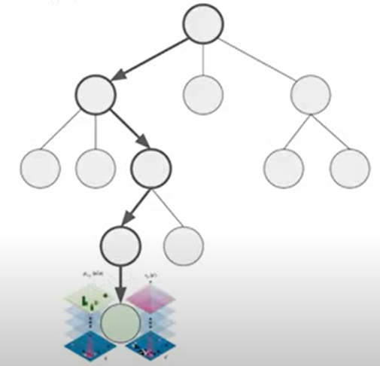
MCTS – Monte Carlo Tree Search
Exploration vs Exploitation trade-off
Actions are either:
Have high policy prior / state-action value
A little is known about
PUCB – Probabilistic Upper Confidence Bound U$\left(s,a\right)=V\left(s,a\right)+P\left(s,a\right)∙C$ $C=\frac{\sqrt{visit_{parent}}}{visit_{child}+1}∙\left(log\left(\frac{visit_{parent}+pb_{base}+1}{pb_{base}}\right)+{pb}_{init}\right)$
MCTS needs a scoring function, a heuristics to select action according to. PUCB is AlphaGo scoring function
The more visits we have, the less weight we want to give to the policy
Evaluate the newfound leaf to get a new policy & value estimates

Slide 7
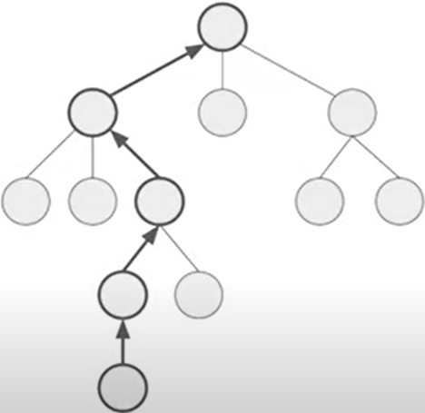
MCTS – Monte Carlo Tree Search
Exploration vs Exploitation trade-off
Actions are either:
Have high policy prior / state-action value
A little is known about
PUCB – Probabilistic Upper Confidence Bound U$\left(s,a\right)=V\left(s,a\right)+P\left(s,a\right)∙C$ $C=\frac{\sqrt{visit_{parent}}}{visit_{child}+1}∙\left(log\left(\frac{visit_{parent}+pb_{base}+1}{pb_{base}}\right)+{pb}_{init}\right)$
MCTS needs a scoring function, a heuristics to select action according to. PUCB is AlphaGo scoring function
The more visits we have, the less weight we want to give to the policy
Backpropagate the value through the tree

Slide 8

AlphaZero
Silver et al., Oct 2017
AlphaGo neural networks trained by supervised learning from human expert moves, and by reinforcement learning from self-play
Here DeepMind introduces an algorithm based solely on RL, without human data, guidance or domain knowledge beyond game rules
AlphaGo becomes its own teacher: a neural network is trained to predict AlphaGo’s own move selections
Starting tabula rasa, AlphaZero achieved superhuman performance, winning 100-0 against AlphaGo

Slide 9

AlphaZero
Silver et al., Dec 2018
Here the same algorithm expanded to play Chess & Shogi as well
In all games, the authors report that the algorithm has learned to play ‘human like’ moves, while has never exposed to human behavior

Slide 10
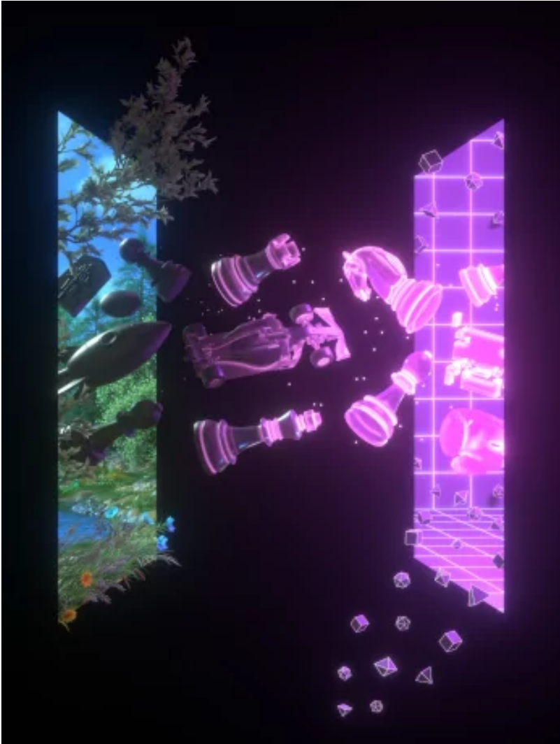
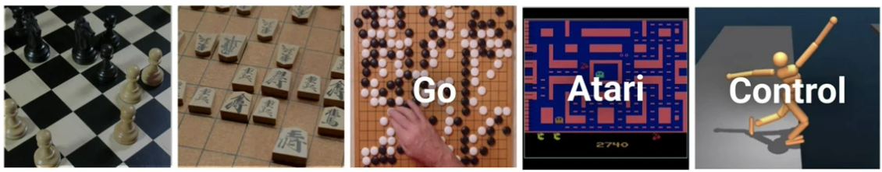
MuZero
Schrittwieser et al., Oct 2020
Takes the next step of evolution – move from board games, where the rules & game dynamics are clearly defined, to any arbitrary domain
MuZero combines a tree-based search with a learned model; the domain dynamics + a reward function
MuZero achieved a state-of-the-art performance of the 57 Atari games suite, where historically planning based methods struggled
Notes:
Atari is a sensible testbed: we can interact with the environment via a simulator, but it is almost impossible to define a set of rules to predict the next state (without using the environment itself)

Slide 11
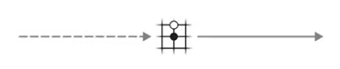
Planning with a Learned Model
In contrast to board games – we can’t role forward the tree search
Since we don’t have access to a simulator anymore

Slide 12
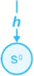
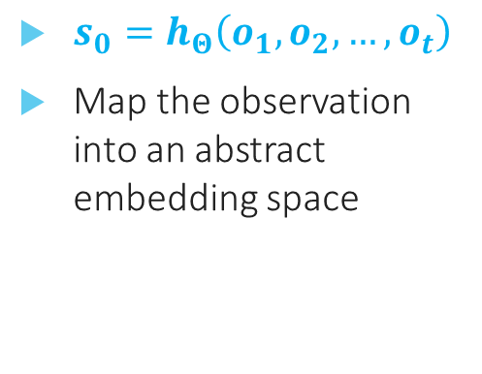
Planning with a Learned Model
$s_{0}=h_{Θ}\left(o_{1},o_{2},…,o_{t}\right)$
Map the observation into an abstract embedding space

Slide 13
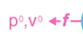
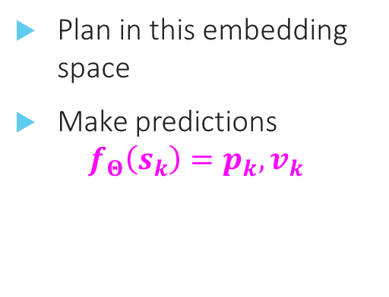
Planning with a Learned Model
Plan in this embedding space
Make predictions
$$f_{Θ}\left(s_{k}\right)=p_{k},v_{k}$$

Slide 14
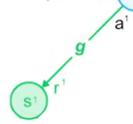
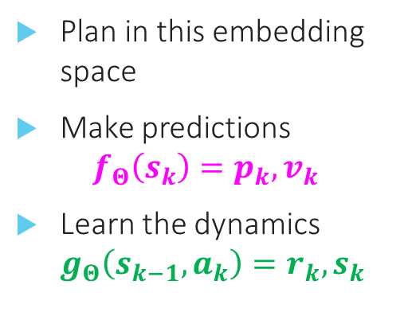
Planning with a Learned Model
Plan in this embedding space
Make predictions $f_{Θ}\left(s_{k}\right)=p_{k},v_{k}$
Learn the dynamics $g_{Θ}\left(s_{k−1},a_{k}\right)=r_{k},s_{k}$

Slide 15
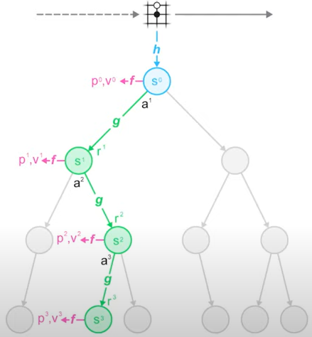
Planning with a Learned Model
Can be seen as a Policy and Value evaluation step
Instead of a single-step lookahead in REINFORCE Policy Grads or Vanilla Actor Critic, here we can look ahead many steps into the future, and by doing so improve our estimates

Slide 16
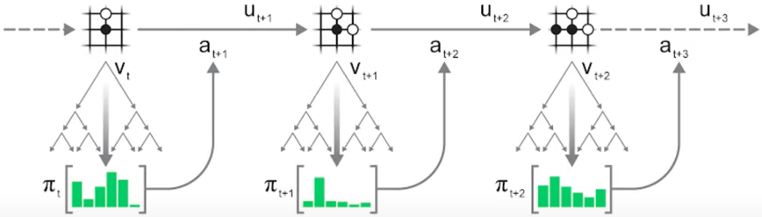
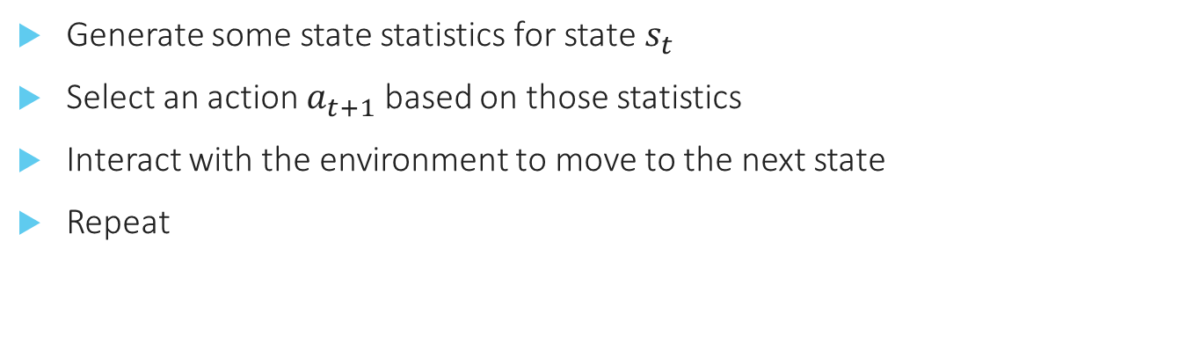
Generate Trajectories Searching at each step
Generate some state statistics for state $s_{t}$
Select an action $a_{t+1}$ based on those statistics
Interact with the environment to move to the next state
Repeat

Slide 17
Dirichlet Noise for Exploration Inside the Search
Dirichlet Noise added to the root prior (policy) estimate
Ensures that eventually all action will be chosen, even if they ideally started with a very low prior
Dirichlet noise was chosen because it is very ‘peaky’: on average it boosts one or two actions while not affecting the others

Slide 18
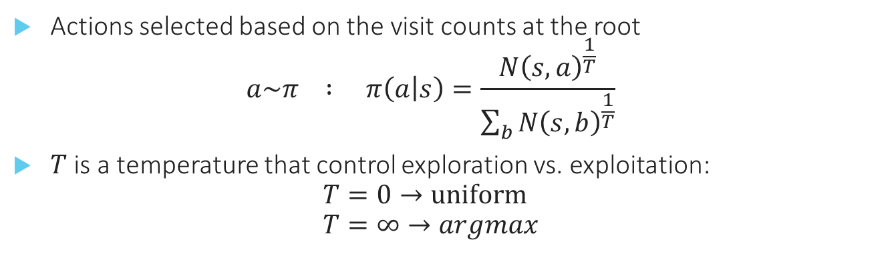
Action Selection
Actions selected based on the visit counts at the root $a\sim π : π\left(a | s\right)=\frac{N{\left(s,a\right)}^{\frac{1}{T}}}{\sum_{b}{N{\left(s,b\right)}^{\frac{1}{T}}}}$
$T$ is a temperature that control exploration vs. exploitation: $T=0→uniform$ $T=∞→argmax$
Notes:
T decays as the training progress: for the first 500k iteration it is 1.0, for the next 250k it is 0.5 and then 0.25.
It promise that the agent will get greedier as the game continues

Slide 19
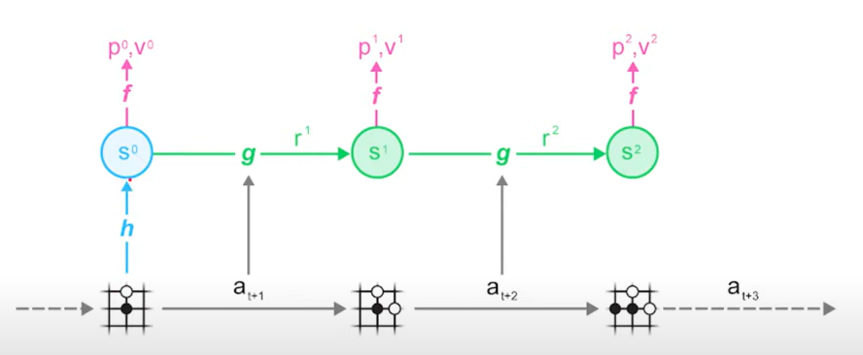

MuZero Training
Unroll the learned model alongside the trajectory
No use of future observations
Real game trajectory

Slide 20
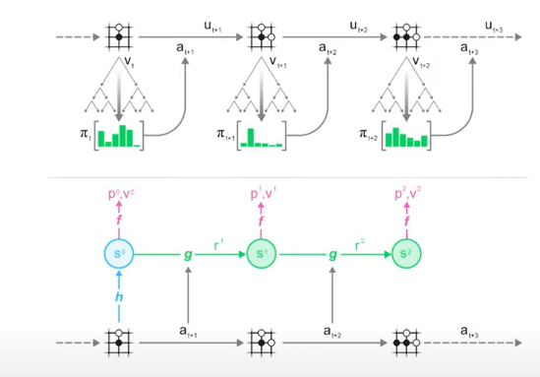
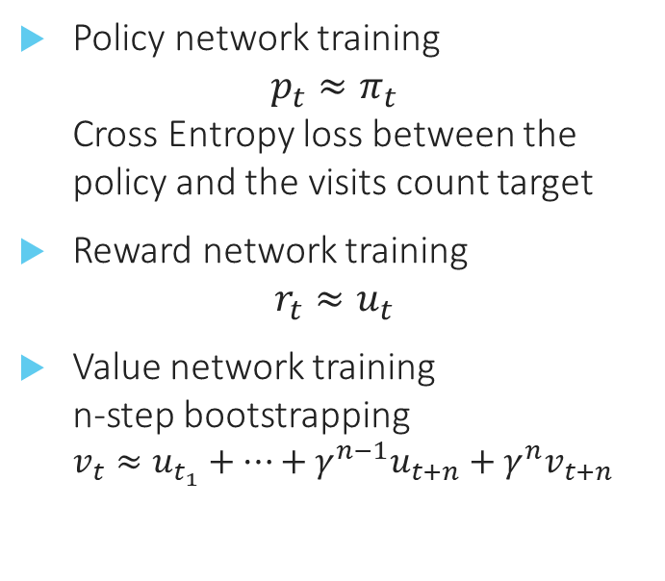
MuZero Training – Cont.
Policy network training $p_{t}≈π_{t}$ Cross Entropy loss between the policy and the visits count target
Reward network training $r_{t}≈u_{t}$
Value network training n-step bootstrapping $v_{t}≈u_{t_{1}}+…+γ^{n−1}u_{t+n}+γ^{n}v_{t+n}$
Notes:
Offline updates – offline algorithm
Off-policy – update the policy against an improved policy, no the current one
Model-based – planning based on learned model

Slide 21
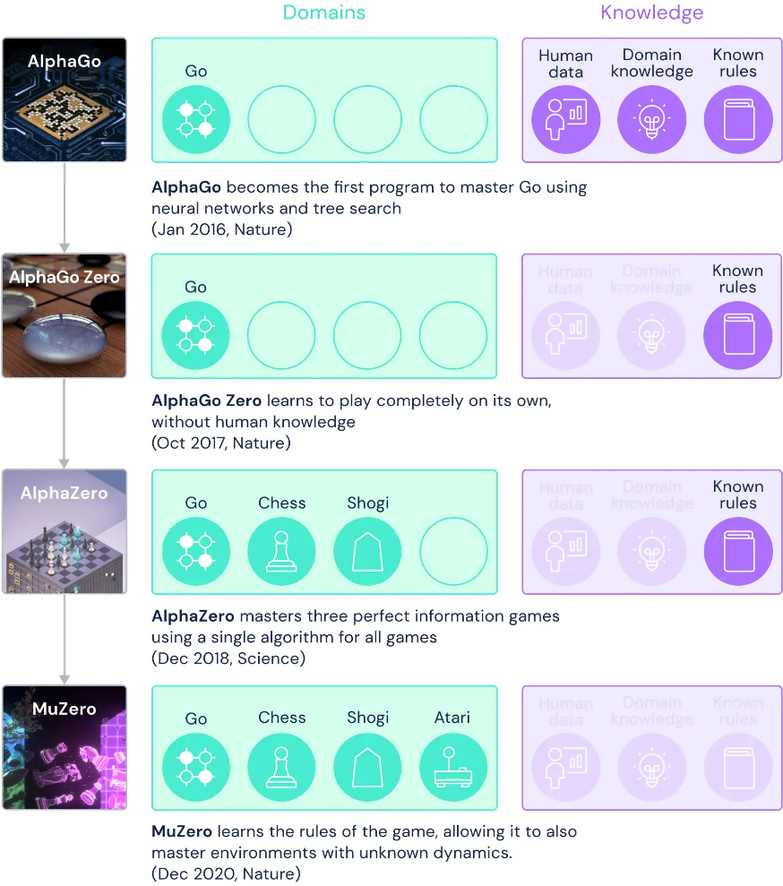
What we had so far?

Slide 22

Sampled MuZero
Hubert et al., PMLR 2021
Many real-world tasks have multidimensional, continuous or complex action spaces. Especially in physical control or robotics
MuZero and its predecessors requires a full enumeration of all possible actions, which is infeasible
A general sample-based policy iteration framework
Sampled MuZero recovered to outstanding performance of MuZero while only using a small sampled subsets of actions
Notes:
* This framework can in principle be applied to any policy iteration-based framework but demonstrated on MuZero.

Slide 23
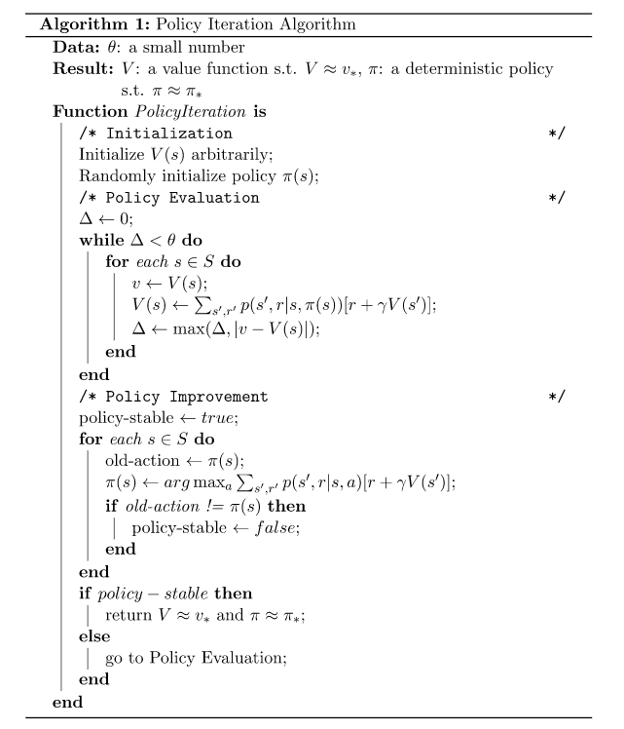
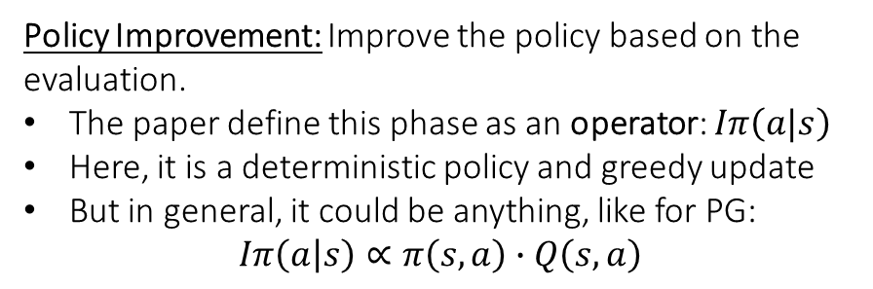
Policy Iteration Recap
Policy Evaluation: given a policy, evaluate each state value function
Policy Improvement: Improve the policy based on the evaluation.
The paper define this phase as an operator: $Iπ\left(a|s\right)$
Here, it is a deterministic policy and greedy update
But in general, it could be anything, like for PG: $Iπ\left(a | s\right)∝π\left(s,a\right)∙Q\left(s,a\right)$

Slide 24
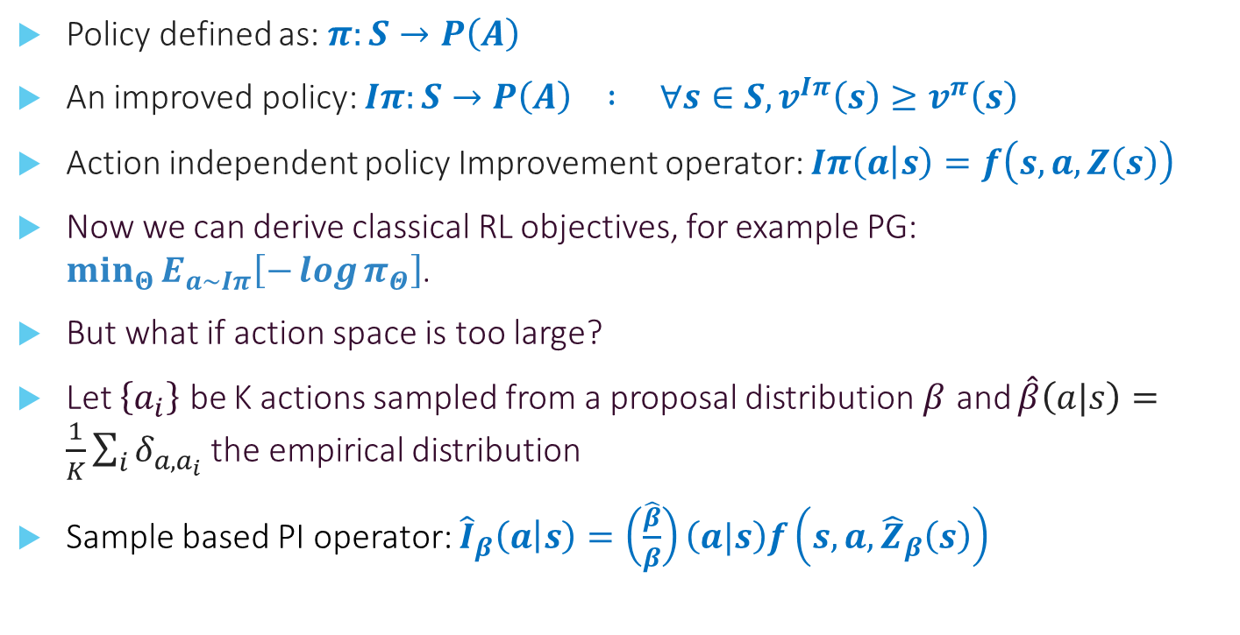
Sample Based Policy Iteration
Policy defined as: $π:S→P\left(A\right)$
An improved policy: $Iπ:S→P\left(A\right) : ∀s∈S,v^{Iπ}\left(s\right)≥v^{π}\left(s\right)$
Action independent policy Improvement operator: $Iπ\left(a | s\right)=f\left(s,a,Z\left(s\right)\right)$
Now we can derive classical RL objectives, for example PG: $\min_{Θ}{E_{a\sim Iπ}\left[−\log{π_{Θ}}\right]}$.
But what if action space is too large?
Let $\left\{a_{i}\right\}$ be K actions sampled from a proposal distribution $β$ and $\hat{β}\left(a|s\right)=\frac{1}{K}\sum_{i}{δ_{a,a_{i}}}$ the empirical distribution
Sample based PI operator: ${\hat{I}}_{β}\left(a | s\right)=\left(\frac{\hat{β}}{β}\right)\left(a|s\right)f\left(s,a,{\hat{Z}}_{β}\left(s\right)\right)$
Notes:
Action independent: $Iπ\left(a | s\right)=f\left(s,a,Z\left(s\right)\right)$
$Z\left(s\right)$ is a normalizing factor: $∀a∈A:f\left(s,a,Z\left(s\right)\right)≥0$ and $\sum_{a}{f\left(s,a,Z\left(s\right)\right)}=1$
the empirical distribution may be different than the proposal distribution because double-sampling the same action
$β$ can be everything: from uniform distribution, to the last learned policy, and even continues.

Slide 25
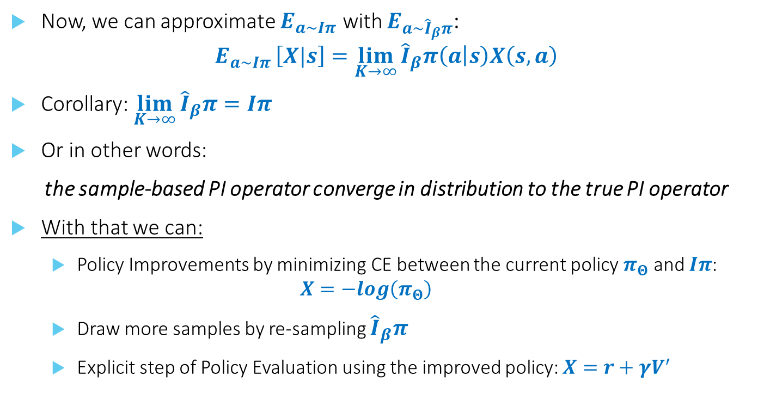
Sample Based Policy Iteration – Cont.
Now, we can approximate $E_{a\sim Iπ}$ with $E_{a\sim {\hat{I}}_{β}π}$: $E_{a\sim Iπ }\left[X|s\right]=\lim_{K→∞}{{\hat{I}}_{β}π\left(a | s\right)X\left(s,a\right)}$
Corollary: $\lim_{K→∞}{{\hat{I}}_{β}π}=Iπ$
Or in other words:
the sample-based PI operator converge in distribution to the true PI operator
With that we can:
Policy Improvements by minimizing CE between the current policy $π_{Θ}$ and $Iπ$: $X=−log\left(π_{Θ}\right)$
Draw more samples by re-sampling ${\hat{I}}_{β}π$
Explicit step of Policy Evaluation using the improved policy: $X=r+γV^{′}$
Notes:
Action independent: $Iπ\left(a | s\right)=f\left(s,a,Z\left(s\right)\right)$
$Z\left(s\right)$ is a normalizing factor: $∀a∈A:f\left(s,a,Z\left(s\right)\right)≥0$ and $\sum_{a}{f\left(s,a,Z\left(s\right)\right)}=1$
the empirical distribution may be different than the proposal distribution because double-sampling the same action
$β$ can be everything: from uniform distribution, to the last learned policy, and even continues.

Slide 26
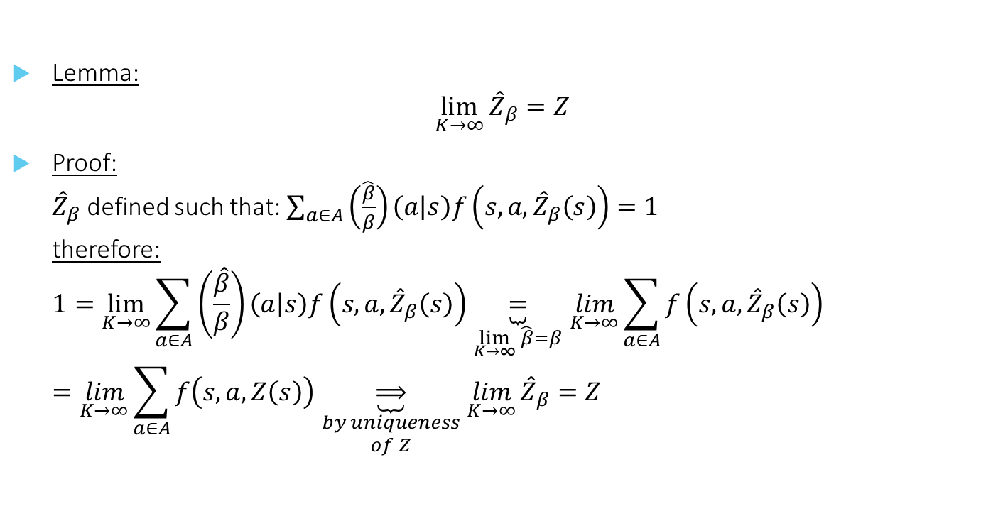
Sample Based Policy Iteration – Proof.
Lemma: ${\lim_{K→∞}{\hat{Z}}}_{β}=Z$
Proof: ${\hat{Z}}_{β}$ defined such that: $\sum_{a∈A}{\left(\frac{\hat{β}}{β}\right)\left(a | s\right)f\left(s,a,{\hat{Z}}_{β}\left(s\right)\right)}=1$ therefore: $1=\lim_{K→∞}{\sum_{a∈A}{\left(\frac{\hat{β}}{β}\right)\left(a | s\right)f\left(s,a,{\hat{Z}}_{β}\left(s\right)\right)}}\underset{\lim_{K→∞}{\hat{β}}=β}{\underbrace{=}}\lim_{K→∞}{\sum_{a∈A}{f\left(s,a,{\hat{Z}}_{β}\left(s\right)\right)}}=\lim_{K→∞}{\sum_{a∈A}{f\left(s,a, Z\left(s\right)\right)}}\underset{\begin{aligned}by uniqueness \\ of Z\end{aligned}}{\underbrace{⟹}}{\lim_{K→∞}{\hat{Z}}}_{β}=Z$

Slide 27
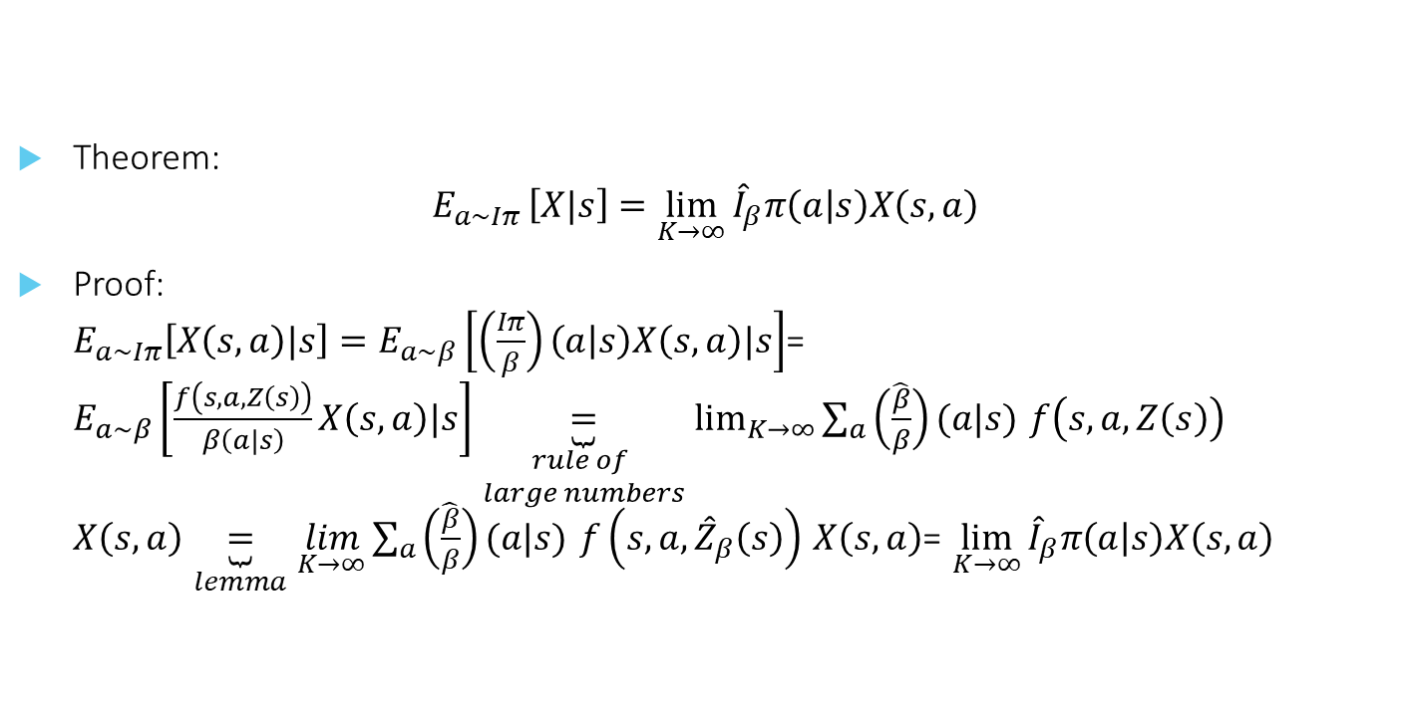
Sample Based Policy Iteration – Proof.
Theorem: $E_{a\sim Iπ }\left[X|s\right]=\lim_{K→∞}{{\hat{I}}_{β}π\left(a | s\right)X\left(s,a\right)}$
Proof: $E_{a\sim Iπ}\left[X\left(s,a\right)|s\right]=E_{a\sim β}\left[\left(\frac{Iπ}{β}\right)\left(a | s\right)X\left(s,a\right)|s\right]$= $E_{a\sim β}\left[\frac{f\left(s,a,Z\left(s\right)\right)}{β\left(a|s\right)}X\left(s,a\right)|s\right]\underset{\begin{aligned}rule of \\ large numbers\end{aligned}}{\underbrace{=}}\lim_{K→∞}{\sum_{a}{\left(\frac{\hat{β}}{β}\right)(a|s)}}$ $f\left(s,a,Z\left(s\right)\right)$ $X\left(s,a\right)\underset{lemma}{\underbrace{=}}$ $\lim_{K→∞}{\sum_{a}{\left(\frac{\hat{β}}{β}\right)(a|s)}}$ $f\left(s,a,{\hat{Z}}_{β}\left(s\right)\right)$ $X\left(s,a\right)$= $\lim_{K→∞}{{\hat{I}}_{β}π\left(a | s\right)X\left(s,a\right)}$

Slide 28
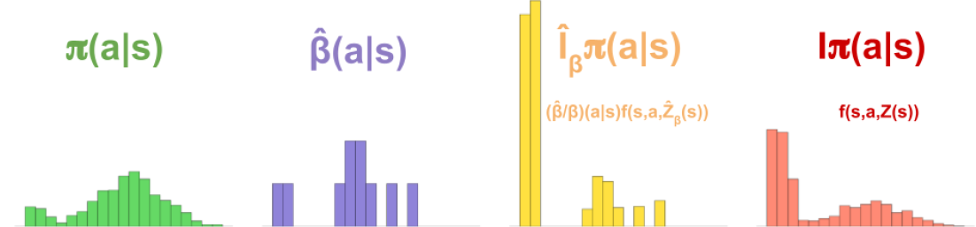
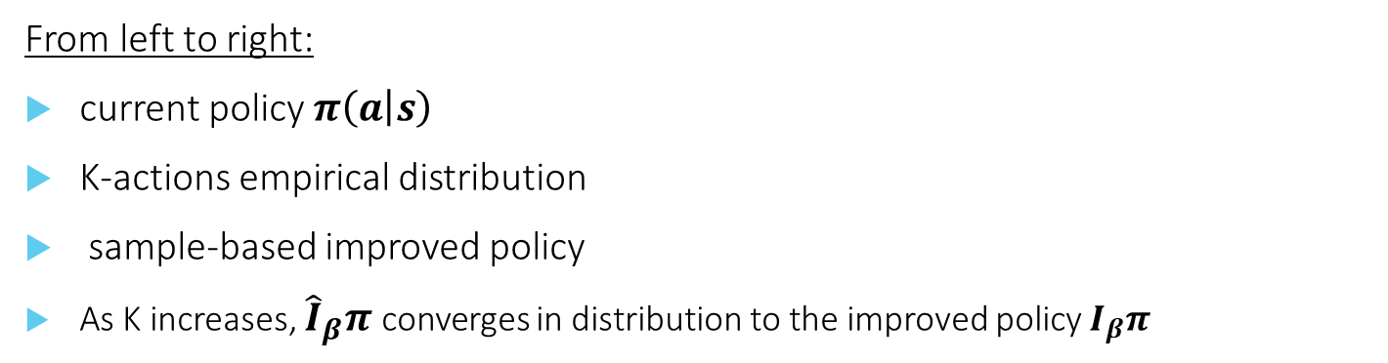
Sample Based Policy Iteration – Cont.
From left to right:
current policy $π\left(a | s\right)$
K-actions empirical distribution
sample-based improved policy
As K increases, ${\hat{I}}_{β}π$ converges in distribution to the improved policy $I_{β}π$

Slide 29
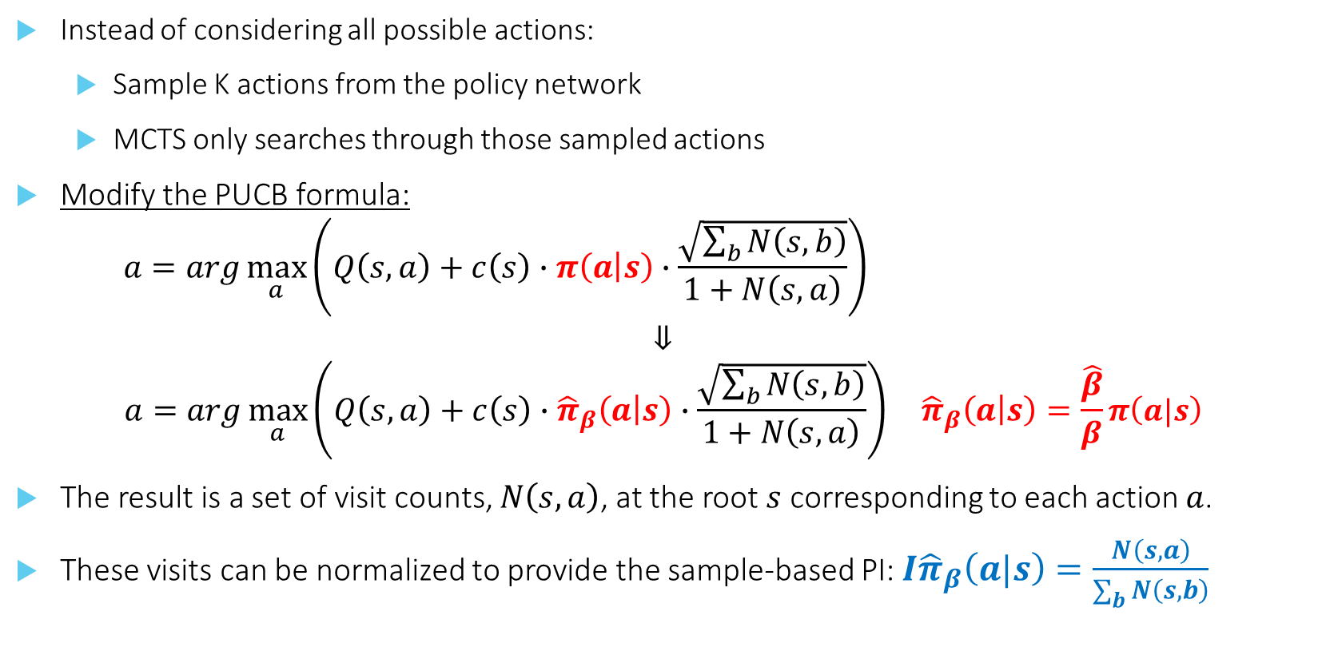
Sampled MuZero
Instead of considering all possible actions:
Sample K actions from the policy network
MCTS only searches through those sampled actions
Modify the PUCB formula:
$$a=arg\max_{a}\left(Q\left(s,a\right)+c\left(s\right)∙π\left(a | s\right)∙\frac{\sqrt{\sum_{b}{N\left(s,b\right)}}}{1+N\left(s,a\right)}\right)$$
$$⇓ \\ a=arg\max_{a}\left(Q\left(s,a\right)+c\left(s\right)∙{\hat{π}}_{β}\left(a | s\right)∙\frac{\sqrt{\sum_{b}{N\left(s,b\right)}}}{1+N\left(s,a\right)}\right) {\hat{π}}_{β}\left(a | s\right)=\frac{\hat{β}}{β}π\left(a|s\right)$$
The result is a set of visit counts, $N\left(s,a\right)$, at the root $s$ corresponding to each action $a$.
These visits can be normalized to provide the sample-based PI: $I{\hat{π}}_{β}\left(a|s\right)=\frac{N\left(s,a\right)}{\sum_{b}{N\left(s,b\right)}}$
Notes:
If $β=π^{1/τ}$ then: ${\hat{π}}_{β}=\frac{\hat{β}}{β}π=\hat{β}π^{1−\frac{1}{τ}}$. If $τ=1$ then: ${\hat{π}}_{β}=\hat{β}$ Means, the sample-based policy is equal to the empirical proposal distribution.

Slide 30
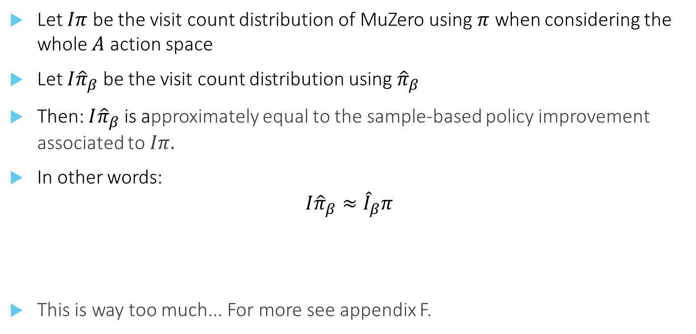
Sampled MuZero – Proof.
Let $Iπ$ be the visit count distribution of MuZero using $π$ when considering the whole $A$ action space
Let $I{\hat{π}}_{β}$ be the visit count distribution using ${\hat{π}}_{β}$
Then: $I{\hat{π}}_{β}$ is approximately equal to the sample-based policy improvement associated to $Iπ.$
In other words:
$$I{\hat{π}}_{β}≈{\hat{I}}_{β}π$$
This is way too much... For more see appendix F.

Slide 31
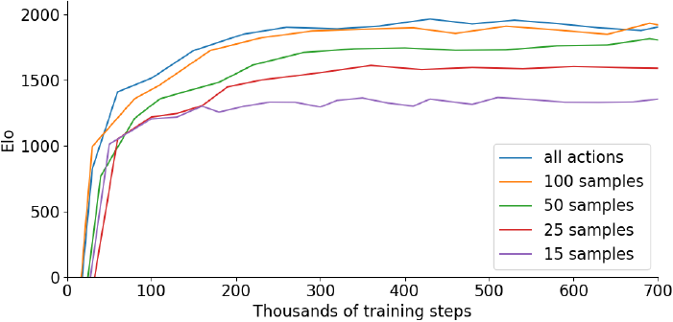
Results
Go Go Go (High Dimensional Discrete Action Space)
MuZero – 362 actions
Notes:
Go is an ideal domain to put Sampled MuZero into test
With less than $K=50$, in steady state, performance are around 50%-75% of MuZero.
362 is the max number of possible actions. But as the game continues, the real number of action is much lower. Not sure if they allow sampling of illegal actions…

Slide 32
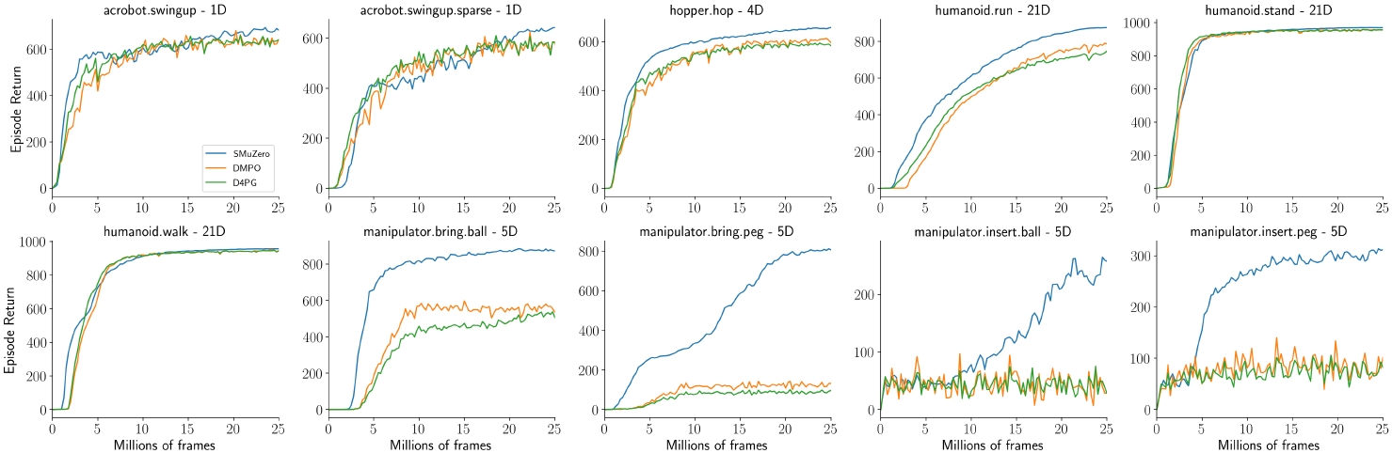
Results
DM Control Suite (Continues Action Space)
Notes:
DMPO & D4PG are two state of the art model-free continues action space algorithms
The manipulator tasks family is considered extremely hard

Slide 33
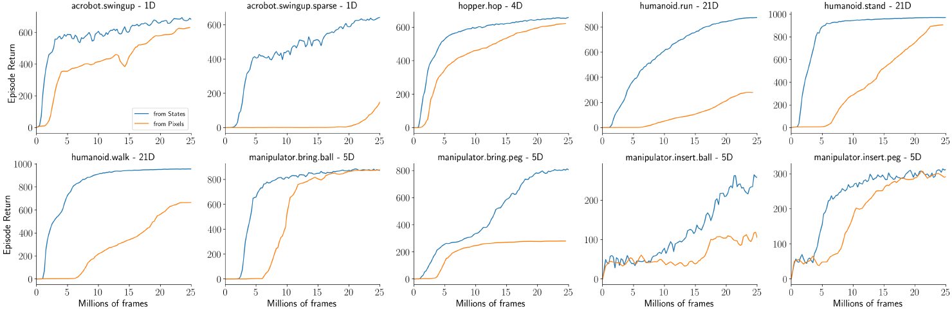
Results
DM Control Suite (Continues Action Space)
Notes:
In most benchmarks, Sampled muZero learn also from raw image pixels, compared to 1D state representation

Slide 34
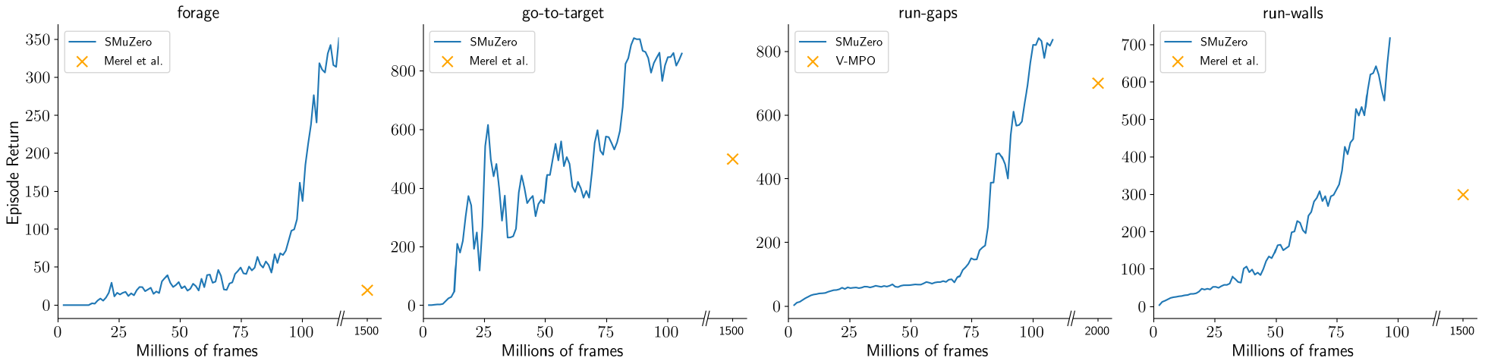
Results
Humanoid Locomotion Environment (Complex Action Space)
Notes:
56 action dimensions
Sampled MuZero outperformed previous state of the art in terms of performance, but also did it in an order of magnitude less interactions with the environment.

Slide 35
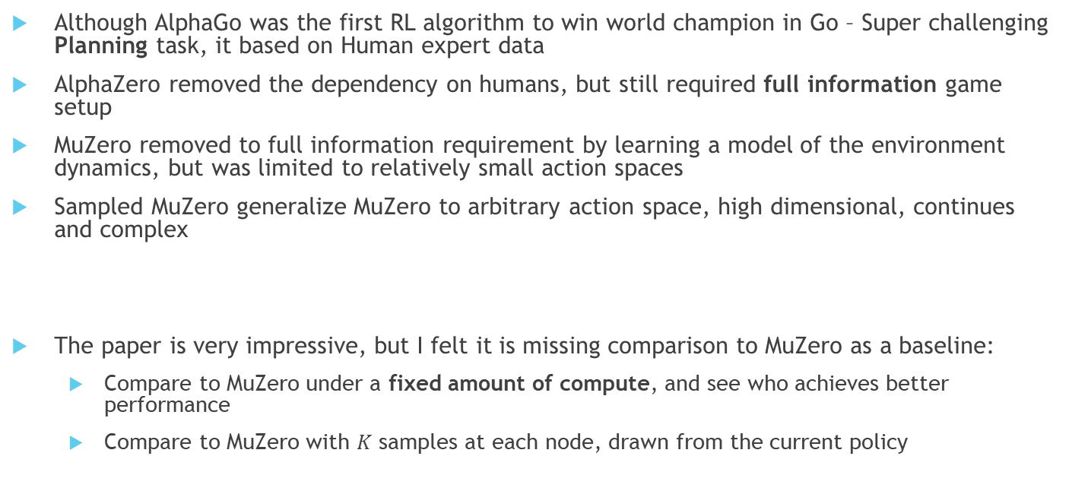
Conclusion ☺
Although AlphaGo was the first RL algorithm to win world champion in Go – Super challenging Planning task, it based on Human expert data
AlphaZero removed the dependency on humans, but still required full information game setup
MuZero removed to full information requirement by learning a model of the environment dynamics, but was limited to relatively small action spaces
Sampled MuZero generalize MuZero to arbitrary action space, high dimensional, continues and complex
The paper is very impressive, but I felt it is missing comparison to MuZero as a baseline:
Compare to MuZero under a fixed amount of compute, and see who achieves better performance
Compare to MuZero with $K$ samples at each node, drawn from the current policy
Notes:
MuZero will probably finish less iterations, because each iteration takes longer, but perhaps each iteration ‘worth more’?
If I understand correctly, it means just less evaluations than MuZero, because MuZero also sample its own policy to evaluate the tree

Slide 36


